Slide 1
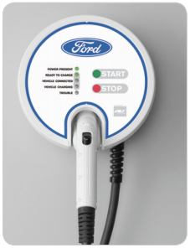


ford CHARGING Station Customer requirements
EDU Project
F
FORDSC Project
karacankos@gmail.com
https://www.linkedin.com/in/omer-karacan/
https://www.instagram.com/karacanos/

Slide 2
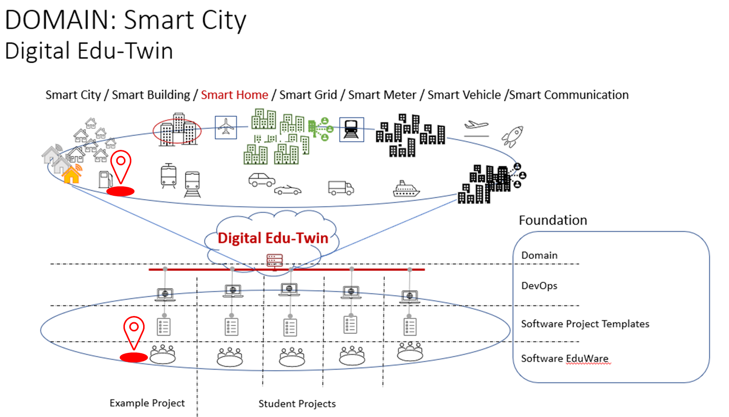

Project Context

Slide 3
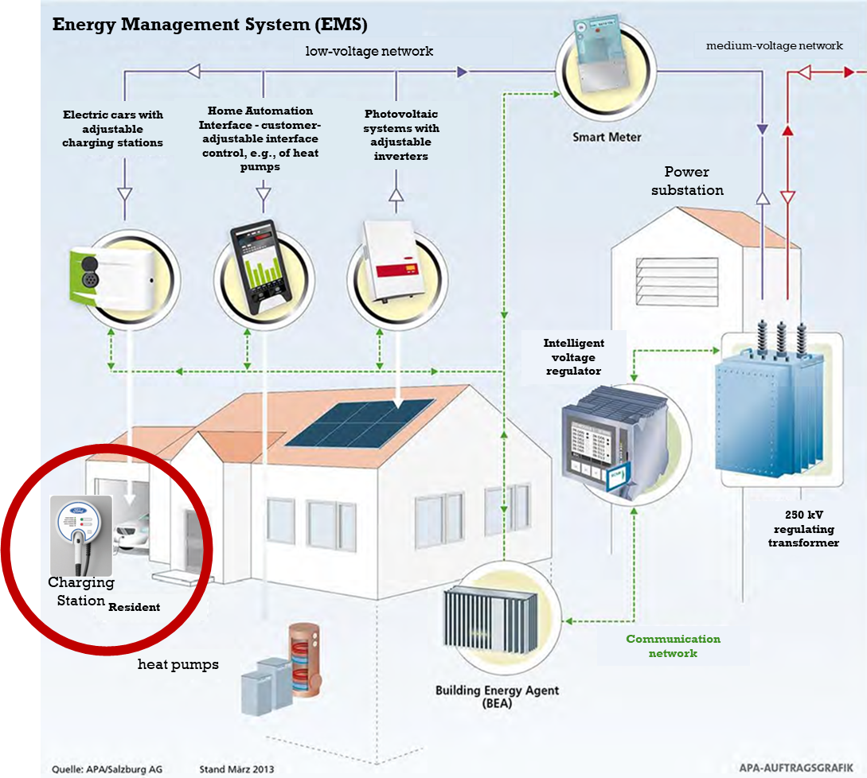
FORD Charging Station CONTEXT SMART HOME

Slide 4


PROJECT FORDCS-V1.0 customer requirements document
<project>
Customer Requirements Document
decomposed from
FORDCS-V1.0
Customer Requirements Document
SmartHome_ConceptSpecificationSimplified_v2022.1.docx

Slide 5
FORDCS V1.0 – Customer Story
Customer wants a demonstration how a given FORD Charging Station (FORDCS) interacts with the person who wants to charge his/her car!
The interaction should be based on an educationally simulated FORDCS, that is,
The behavior of the FORDCS should be defined by a state machine which is based on the status LEDs and their description given in a picture of the FORDCS Data Sheet (https://www.evsolutions.com/Upload/Product/635652466512570000.pdf)
The human-machine interaction (User Interface) should be based on
the status LEDs given in a picture, and
the technical characteristics given in a table of the FORDCS Data Sheet (https://www.evsolutions.com/Upload/Product/635652466512570000.pdf)
The application execution environment is the Cloud, i.e., it should be deployed to the Cloud and the acceptance test should be conducted!

Slide 6
FORDCS-V1.0 – Customer Requirements
The FORDCS customer requirements are defined via decomposition from the SMARTHOME project, see [REF_SHC]
The FORDCS customer requirements comprises
the FORDCS Data Sheet (PRIMARY SOURCE), and
The illustrations, Use Cases, and explanations in this presentation document (SECONDARY SOURCE), and
The human-machine interface defined by Swagger RESTful web services (TRINITY SOURCE)!
Project : https://app.swaggerhub.com/apis/karacankos/fordcs/1.0-oas3
Swager document : https://app.swaggerhub.com/apis-docs/karacankos/fordcs/1.0-oas3
Shared : https://app.swaggerhub.com/apis/karacankos/fordcs/1.0-oas3
Artifacts should be created according to “EDUp-Full-Stack-Software-Project-Development-Method”
The requirement gaps (issues) are resolved with intellectual assumptions and should be explained in this document!

Slide 7


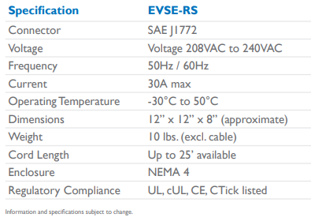


FORDCS-V1.0 Use Case Report Factory Setting
Use Case
Report Factory Setting V1.0
Domain Model
Web Service
guest
service

Slide 8

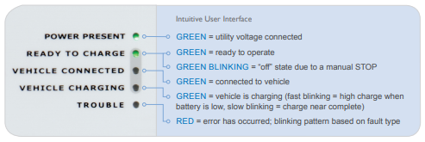


FORDCS-V1.0 Use CaseS: Run-time Status Report, Monitor and Control Run-time Status
Web Service
Use Case
Run-time Status Report V1.0
UX
guest
Use Case
Monitor and Control Run-time Status V1.0
V1.0
W/O LED COLOR STATUS
V1.0 does not consider the LED’s color-based charging status information.
service

Slide 9
FORDCS-V1.0 EXPECTED SYSTEM Behavior (W/o LED STATUS)
V1.0 Model version: 2022.03
e: power_on
t: power_on
Events:
power_on
ready_to_charge
vehicle_disconnected
start_charging
stop_charging
vehicle_connected
failure
power_off
POWER OFF
e: ready_to_charge
t: ready_to_charge
e: power_off
t: power_off
e: vehicle_disconnected
t: ready_to_charge
UX_POWER_PRESENT
UX_ READY_TO_CHARGE
INITIAL_STATE
e: vehicle_connected
t: vehicle_connected
UX_ VEHICLE_ CONNECTED
e: failure_fixed
t: ready_to_charge
States:
INITIAL_STATE
POWER_OFF
UX_POWER_PRESENT
UX_ READY_TO_CHARGE
UX_ VEHICLE_CONNECTED
UX_ VEHICLE_CHARGING
UX_ TROUBLE
e: failure
t: failure
e: stop_charging
t: vehicle_connected
UX_ TROUBLE
UX_ VEHICLE_CHARGING
e: start_charging
t: start_charging

Slide 10
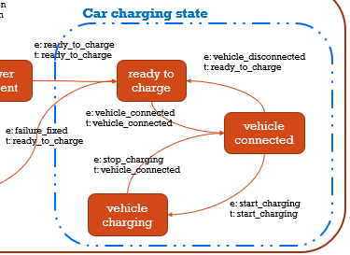
Car charging state State/Event Table MANDATORY test cases (ACCEPTANCE TEST)
Test Case | TC #1 | TC #2 | TC #3 | TC #4
Start state | Ready to charge | Vehicle connected | vehicle charging | Vehicle connected
Event/Input | Vehicle_connected | Start_charging | Stop_charging | Vehicle_disconnected
Expected Output | «Vehicle connected» | «vehicle charging» | «Vehicle connected» | «Vehicle disconnected»
End state | Vehicle connected | vehicle charging | Vehicle connected | Ready to charge

Slide 11





RECOMMENDED DEVELOPMENT/TEST ENVIRONMENT FORD CHARGER ApplIcatIon
ca. 15 min.
<SpringBootApplication,
charger-station-application>
cs
3 roles
<external-db>
UX/UI
<Repository>
GappRepository
<Service>
GappService
<Controller>
GappController
Tester
Java Persistence (JAP) API
<entity>
GappData
<embedded-db>
Hibernate
Developer
<external-db>
MySQL
<persistency>
data storage
<algorithm>
business logic
<endpoints>
gapp APIs
Notes:
CHECK: https://objectbox.io/how-ev-charging-benefits-from-edge-computing/

Slide 12
PROJECT FORDCS V2.0 Future Project
OUT-OF-SCOPE

Slide 13

FORD Charging station V2.0 SYSTEM Behavior SYSTEM Black-BOX
Web Service
Use Case
Run-time Status Report V2.0
UX
guest
Use Case
Monitor and Control Run-time Status V2.0
V2.0
CONSIDERING LED STATUS
GREEN_BLINKING (manual stop)
VEHICLE_CHARGING GREEN STATUS LED
FAST BLINKING, SLOW BLINKING
TROUBLE RED STATUS LED
PERMENANT, FAST BLINKING, SLOW BLINKING
service
Use Case
Run-time Failure V2.0
incident

Slide 14
SYSTEM Behavior V2.0 (W/ RED & GREEN STATUS) SYSTEM WHITE-BOX
Events:
Power_on
Ready_to_charge
Ready_to_charge_manuel_stop
Vehicle_disconnected
Start_charging
Stop_charging
Vehicle_connected
Failure_fixed
Failure_internal
Failure_data
Failure_hw
Power_off
V2.0 Model version: 2022.01
READY_TO_CHARGE_STOPPED
e: power_on
t: power_on
e: ready_to_charge_manuel_stop
t: ready_to_charge_stop
e: ready_to_charge
t: ready_to_charge
POWER OFF
e: ready_to_charge
t: ready_to_charge
e: power_off
t: power_off
UX_ POWER_PRESENT
UX_ READY_TO_CHARGE
e: failure_fixed
t: power_on
e: vehicle_disconnected
t: ready_to_charge
States:
INITIAL_STATE
POWER_OFF
UX_ POWER_PRESENT
UX_ READY_TO_CHARGE
READY_TO_CHARGE_STOPPED
UX_ VEHICLE_CONNECTED
UX_ VEHICLE_CHARGING
UX_ TROUBLE
INITIAL_STATE
e: vehicle_connected
t: vehicle_connected
e: failure_fixed
t: ready_to_charge
UX_ VEHICLE_CONNECTED
UX_ TROUBLE
e: stop_charging
t: vehicle_connected
e: failure_internal, failure_data, failure_hw
t: failure
e: start_charging
t: start_charging
UX_ VEHICLE_CHARGING

Slide 15
BACKYARD
Wichtige Informationen

Slide 16
REFERENCES
[REF_SHC] … SmartHome_ConceptSpecificationSimplified_v2022.1.docx, especially
Use Case „Charge the E-car“ , chapter 3.2.1
The Subsystem “Charging Station”, , chapter 4.2
[REF_FORDCS] … FORD – Charging Station
https://www.evsolutions.com/Upload/Product/635652466512570000.pdf

Slide 17
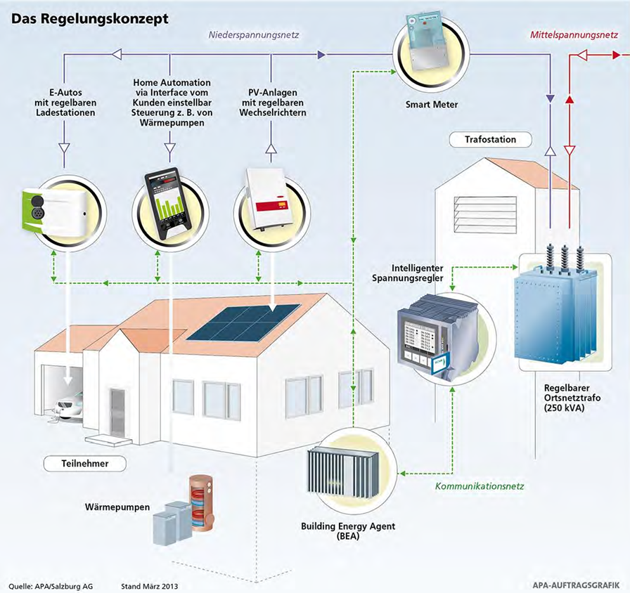
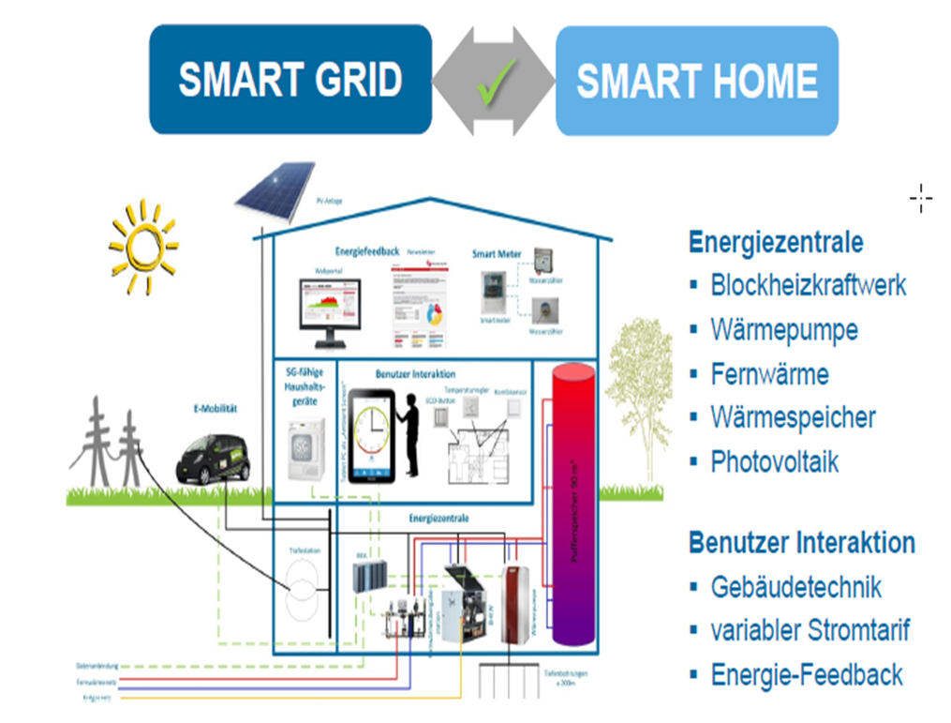
FORDCS CONTEXT – SMART HOME
Energy Management System (EMS)
low-voltage network
medium-voltage network
Electric cars with adjustable charging stations
Home Automation Interface - customer-adjustable interface control, e.g., of heat pumps
Photovoltaic systems with adjustable inverters
Power substation
Intelligent voltage regulator
250 kV regulating transformer
Charging Station
Resident
Communication network
heat pumps

